Slide 1
REAL-TIME DIRECTIONAL ANTENNA ALIGNMENT USING REINFORCEMENT LEARNING AND RSSI FEEDBACK
Atul Tiwari (THA079BEI006)
Bibek Joshi (THA079BEI007)
Inisha Maharjan (THA079BEI012)
Suprim Koirala (THA079BEI043)
Supervisor:
Er. Saroj Shakya
Department of Electronics and Computer Engineering
Institute of Engineering, Thapathali Campus
December 28, 2025

Slide 2
Presentation Outline
Motivation
Introduction
Objectives
Scope of Project
Methodology
Expected Outcomes
Project Timeline
Budget Estimation
Project Applications
References

Slide 3
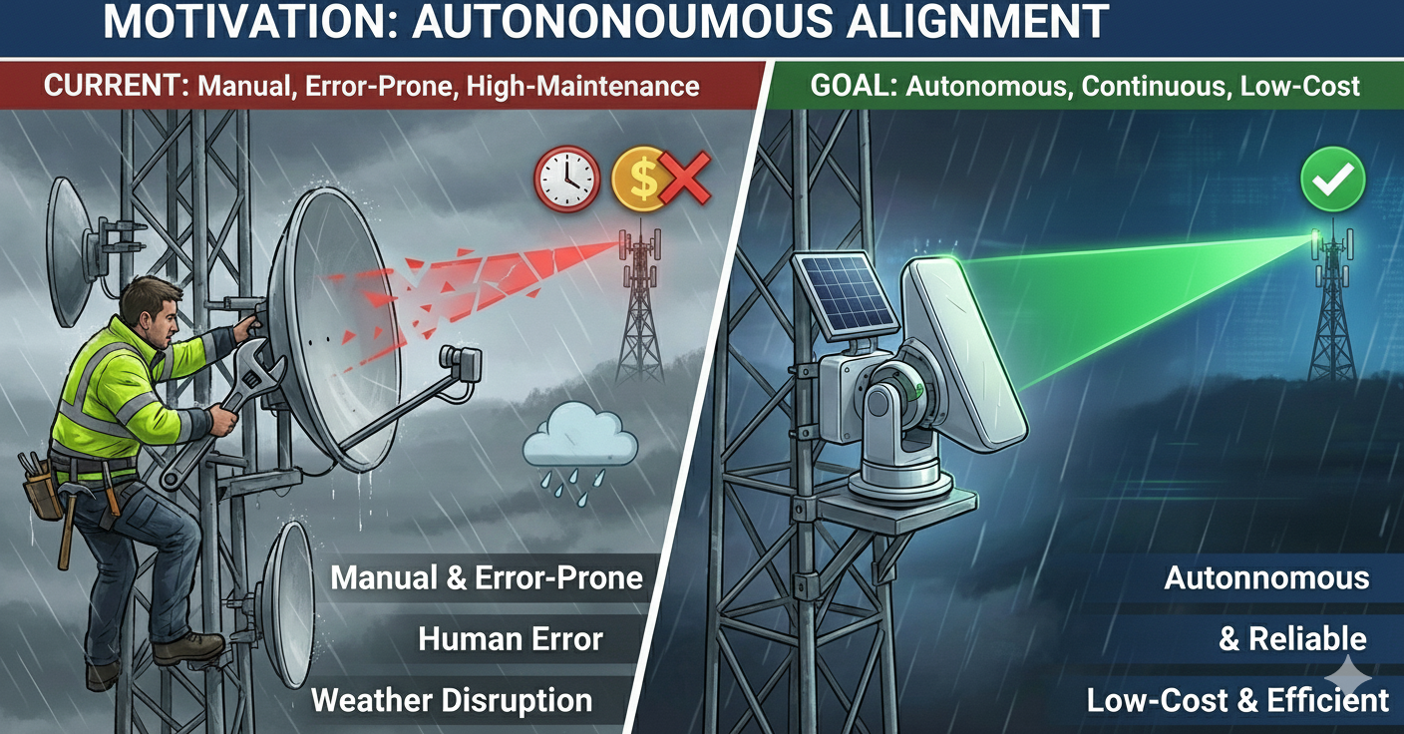
Motivation
Figure: Image Generated by NanoBanana (Gemini)

Slide 4
Introduction
Directional antennas focus energy to improve SNR & range
Alignment crucial for reliable communication
Manual alignment is time-consuming and error-prone
Existing automated methods require costly RF hardware
Low-cost, RSSI-based autonomous alignment is needed

Slide 5
Objectives
To design and implement a low-cost embedded system capable of measuring RSSI in real time and mechanically steering a directional antenna.
To develop and evaluate lightweight reinforcement learning based alignment strategies, comparing their performance against baseline methods.

Slide 6
Scope of Project
Capabilities
Implement stepper-controlled antenna using microcontroller
Develop baseline RSSI scanning and hill-climb algorithms
Integrate lightweight reinforcement learning for antenna control
Evaluate performance in static and dynamic environments
Limitations
Advanced multi-antenna systems like MIMO, phased arrays
High-frequency mm-Wave and beamforming techniques
Transmitter-side adaptation or coordinated alignment
Full mobility and high-speed movement scenarios
RSSI variability limits experimental repeatability

Slide 7
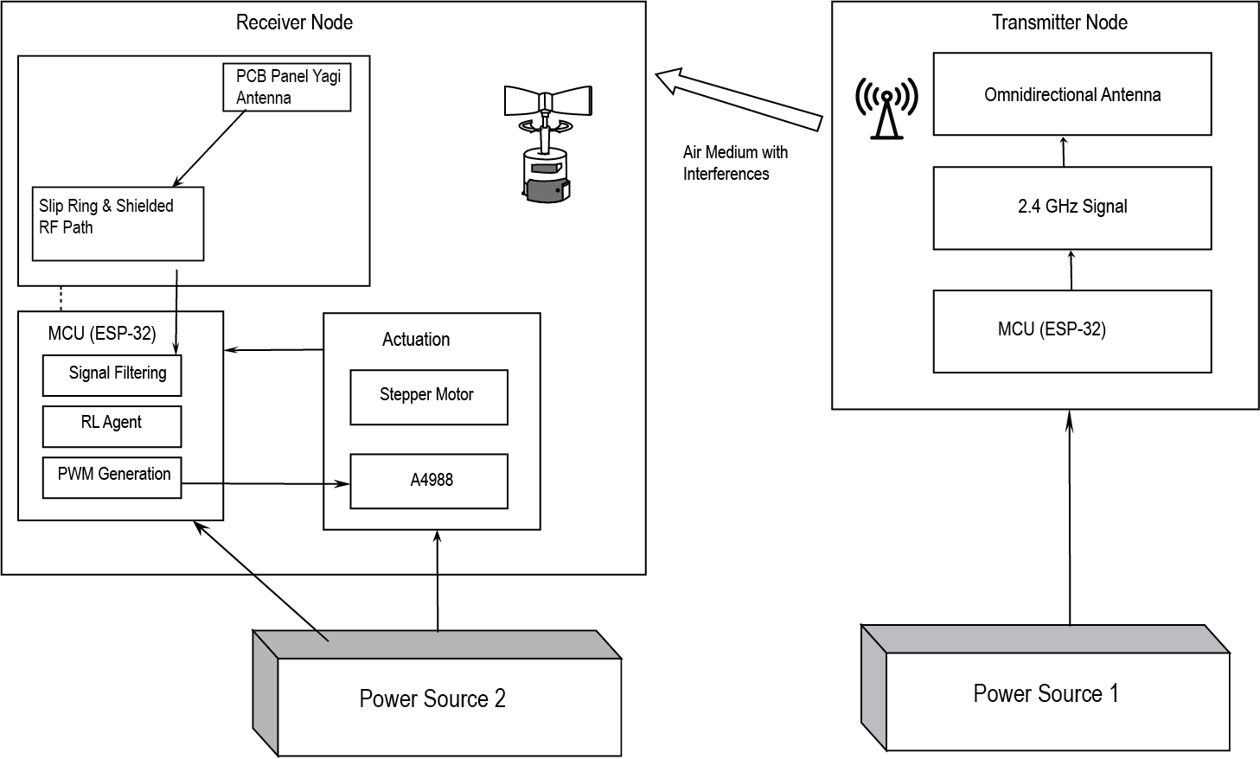
Methodology (1)
System Block Diagram

Slide 8
Methodology (2)
Hardware Implementation
Antenna: High-gain directional Panel PCB Type.
Processor: ESP32 or Arduino for logic execution.
Actuator: NEMA 17 Stepper Motor for precision.
Driver: A4988 driver for smooth motor control.
Power: External 12V supply for motor torque.

Slide 9
Methodology (3)
Source and Receiver Configuration
Transmitter Node​
    ESP32 microcontroller​
    Omnidirectional antenna​
    Periodic Data Transfer
Receiver Node​
    ESP32 microcontroller​
    Directional antenna​
    Stepper motor assembly
    Alignment Algorithm

Slide 10
Methodology (4)
Software Implementation
Arduino IDE with ESP32 Core
Embedded C/C++ Firmware
Lightweight Q-Learning Algorithm
Serial Monitor and Plotter
Python / MATLAB for Data Analysis
PyTorch Library for RL Algorithm Implementation

Slide 11
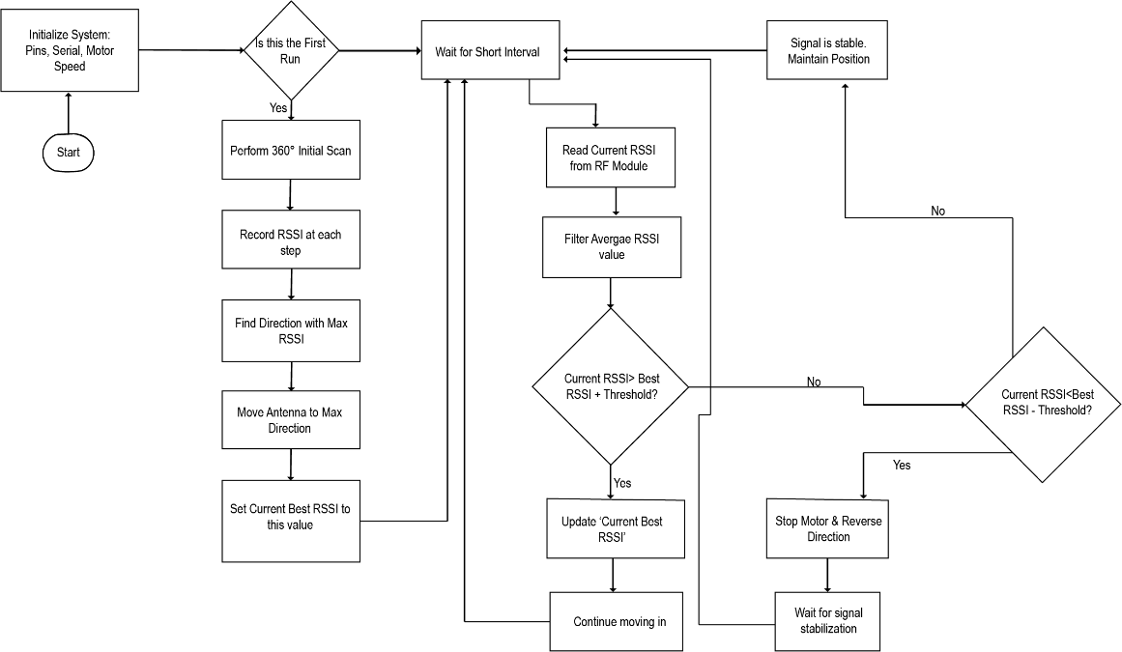
Methodology (5)
Flow Diagram

Slide 12
Methodology (6)
Baseline Methods
Fixed orientation (no adaptation)
Exhaustive angular scanning
RSSI-based hill-climbing
Comparison metric for RL performance

Slide 13
Methodology (7)
Reinforcement Learning Overview
Model-free control paradigm
Learn from interaction & rewards
Optimize antenna orientation over time
Tabular Q-Learning
Suitable for low-cost embedded systems

Slide 14
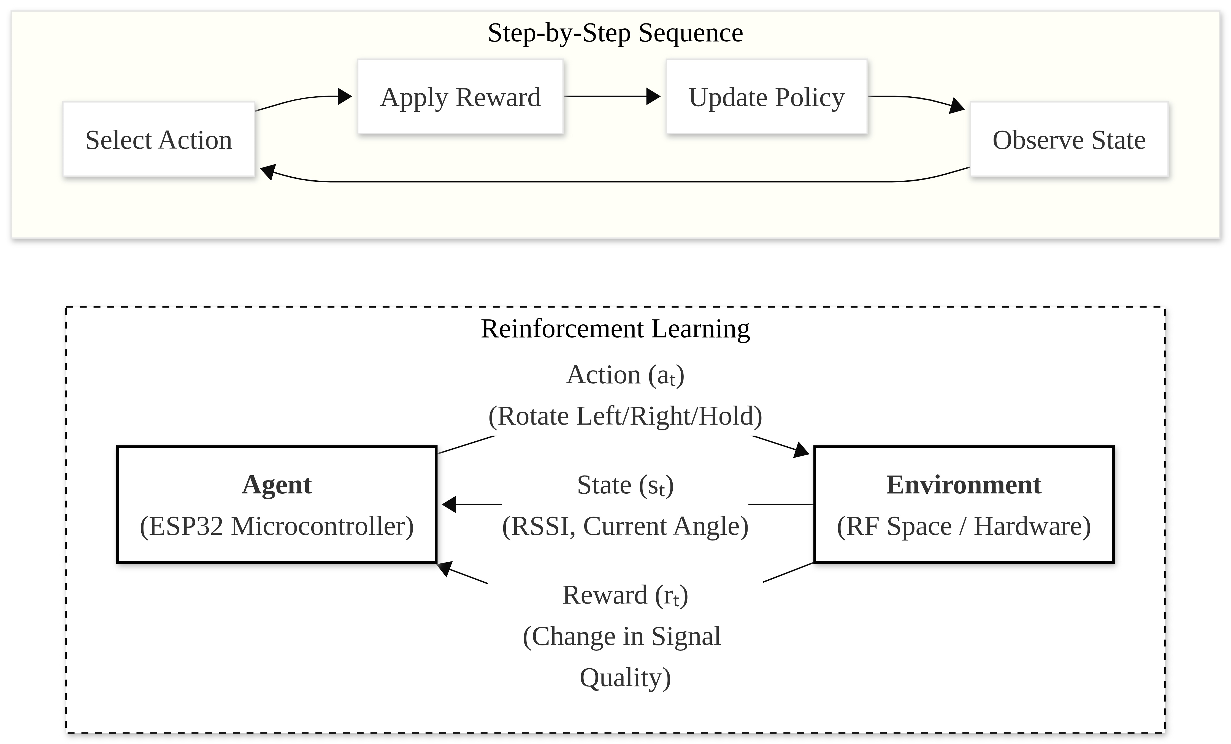
Methodology (8)
RL Model Design

Slide 15
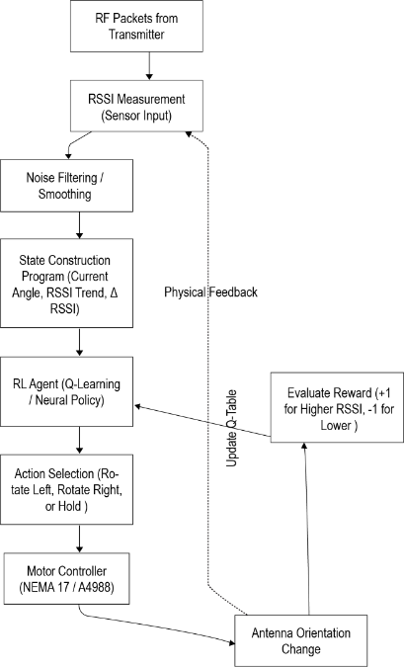
Methodology (9)
RL Experience Collection and State Preparation Pipeline

Slide 16
Methodology (10)
Working Principle
Initialize antenna at a baseline position.
Scan environment to establish initial RSSI.
Agent selects action based on current state.
Measure new RSSI and calculate reward.
Update Q-table or Policy to improve accuracy.
Repeat cycle for continuous real-time tracking.

Slide 17
Methodology (11)
Reinforcement Learning Framework
State Space:
  Current RSSI level and signal trend.
  Current angular position of the antenna.
  Thresholds classify RSSI increase/decrease/stable
Action Space:
  Rotate clockwise, counter-clockwise, or stay.
  Step size trade-off: precision vs. speed
Reward Function:
  Positive reward for increased signal strength.
  Penalty for signal drops or unnecessary movement.

Slide 18
Methodology (12)
Algorithm in Action
Tabular Q-learning used for model training
Antenna movement generates learning experience
Experience includes state, action, reward, next
RSSI acts as primary reward signal
Q-values updated after every action

Slide 19
Methodology (13)
Exploration Strategy
  ε-greedy strategy enables initial exploration
  Exploration gradually reduces during learning
  Model adapts to environmental change
  Training converges at stable maximum RSSI

Slide 20
Methodology (14)
Experimental Setup
Indoor lab/corridor for multipath testing
Outdoor line-of-sight environment
Random initial antenna misalignment
Repeated trials (N ≥ 20) for reliability

Slide 21
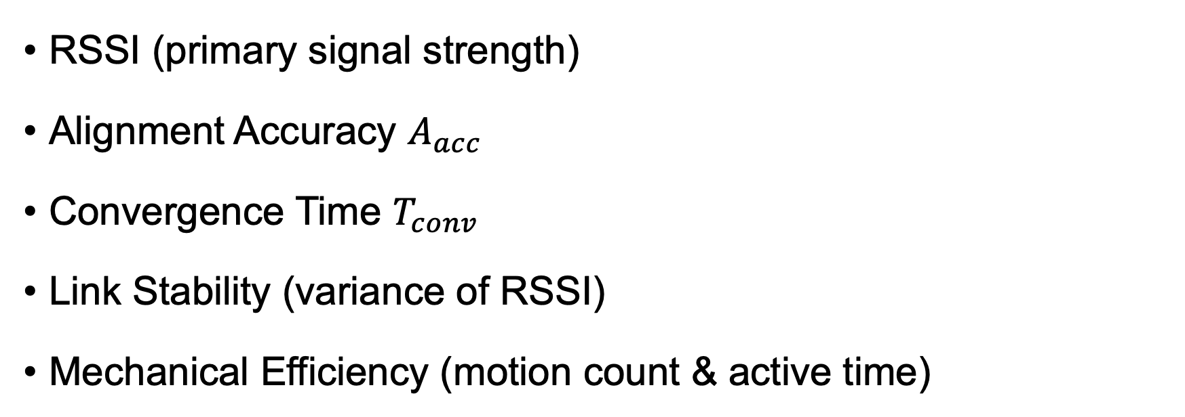
Methodology (15)
Evaluation Metrics
RSSI (primary signal strength)
Alignment Accuracy $A_{acc}$​
Convergence Time $T_{conv}$​
Link Stability (variance of RSSI)
Mechanical Efficiency (motion count & active time)

Slide 22
Expected Outcomes (1)
Functional Autonomous Alignment Prototype
Improved Alignment Performance Compared to Baseline Methods
Feasibility of RL on Resource Constrained Hardware
Quantitative Performance Evaluation and Analysis
Validated, Low-Cost, and Replicable Design

Slide 23
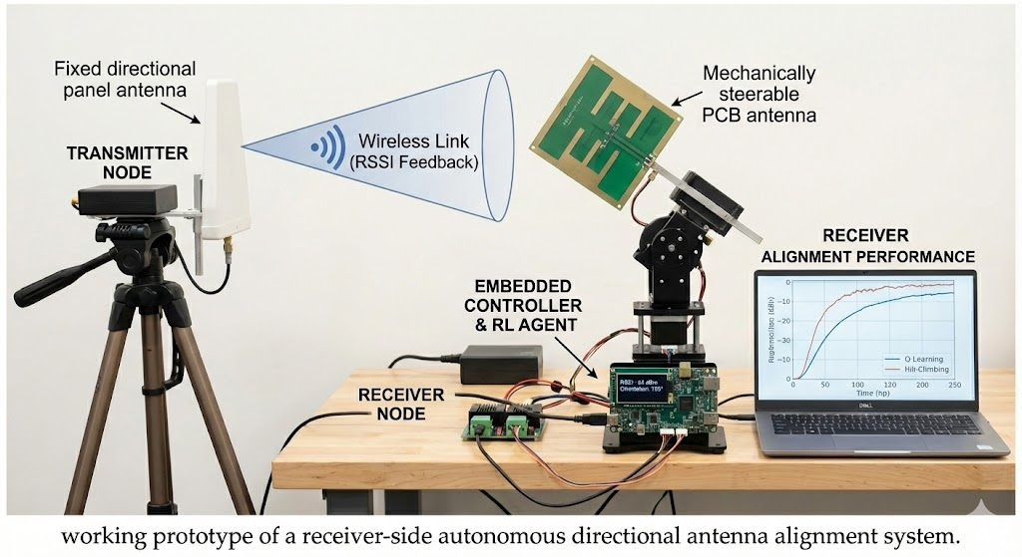
Expected Outcomes (2)
Figure: Image Generated by NanoBanana

Slide 24
Project Applications
Improving reliability and range of fixed wireless links
Enhancing signal stability in IoT or sensor networks with directional antennas
Low cost point-to-point wireless communication systems where manual alignment is impractical
Educational and research platforms for exploring embedded RL in real-time RF control

Slide 25
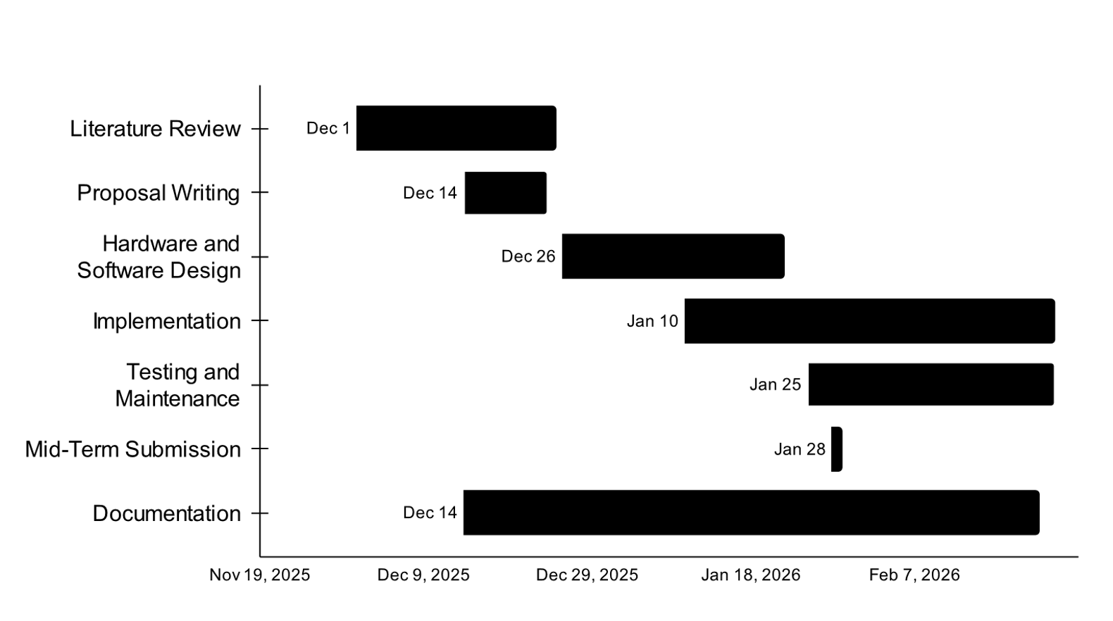
Project Timeline [Gantt Chart]

Slide 26
Budget Estimation
Item | Quantity | Estimated Cost (NRs.)
Microcontroller ESP32 DevKit | 2 | 2400 - 3500
NEMA 17 Stepper Motor | 1 | 1,500
A4988 Motor Driver | 1 | 350
100uF Capacitor | 5 | 100
18650 Li-Ion Battery (High Drain) | 3 | 1500
3S 18650 Battery Holder | 1 | 150
3S 20A BMS Board | 1 | 350
LM2596 Buck Converter | 1 | 600
2.4GHz Yagi Antenna | 1 | 700 - 2,500
Pigtail Cable (SMA) | 1 | 400
Logistics | - | 1000
Total Estimated Cost |  | 9000 – 12000 (approx.)

Slide 27
References I
[1] C. Beard and W. Stallings, Wireless Communication Networks and Systems. Pearson, 2016.
[2] S. Ahmed et al., “Comparative analysis of machine learning algorithms for antenna alignments,” IEEE Access, 2021.
[3] A. T. Koru, J. Chang, and Y. Wan, “RSSI-based distributed control to align directional antenna pairs for UAV communication,” IEEE/ASME Transactions on Mechatronics, 2024.
[4] Y. Wan et al., “Received signal strength indicator-based decentralized control for robust long-range aerial networking using directional antennas,” IEEE Transactions on Aerospace and Electronic Systems, 2018.

Slide 28
References II
[5] J. W. Smith et al., “SmartAntenna: Enhancing wireless range with autonomous orientation,” International Journal of Distributed Sensor Networks, 2019.
[6] Á. L. Makara, B. T. Csathó, A. Rácz, T. Borsos, L. Csurgai-Horváth, and B. P. Horváth, “Deep-Learning-Based Antenna Alignment Prediction for Mobile Indoor Communication,” Sensors, vol. 23, no. 7, p. 3375, 2023, doi: 10.3390/s23073375.
[7] R. S. Sutton and A. G. Barto, Reinforcement Learning: An Introduction, 2nd ed. Cambridge, MA, USA: MIT Press, 2018. ISBN 978-0262039246.

